Slide 1

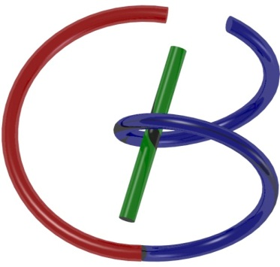
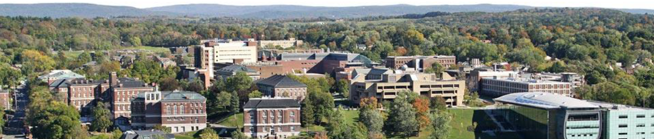
38655 BMED-2300-02
Lecture 12: X-ray Radiography
Ge Wang, PhD
Biomedical Imaging Center
CBIS/BME, RPI
wangg6@rpi.edu
March 2, 2018

Slide 2
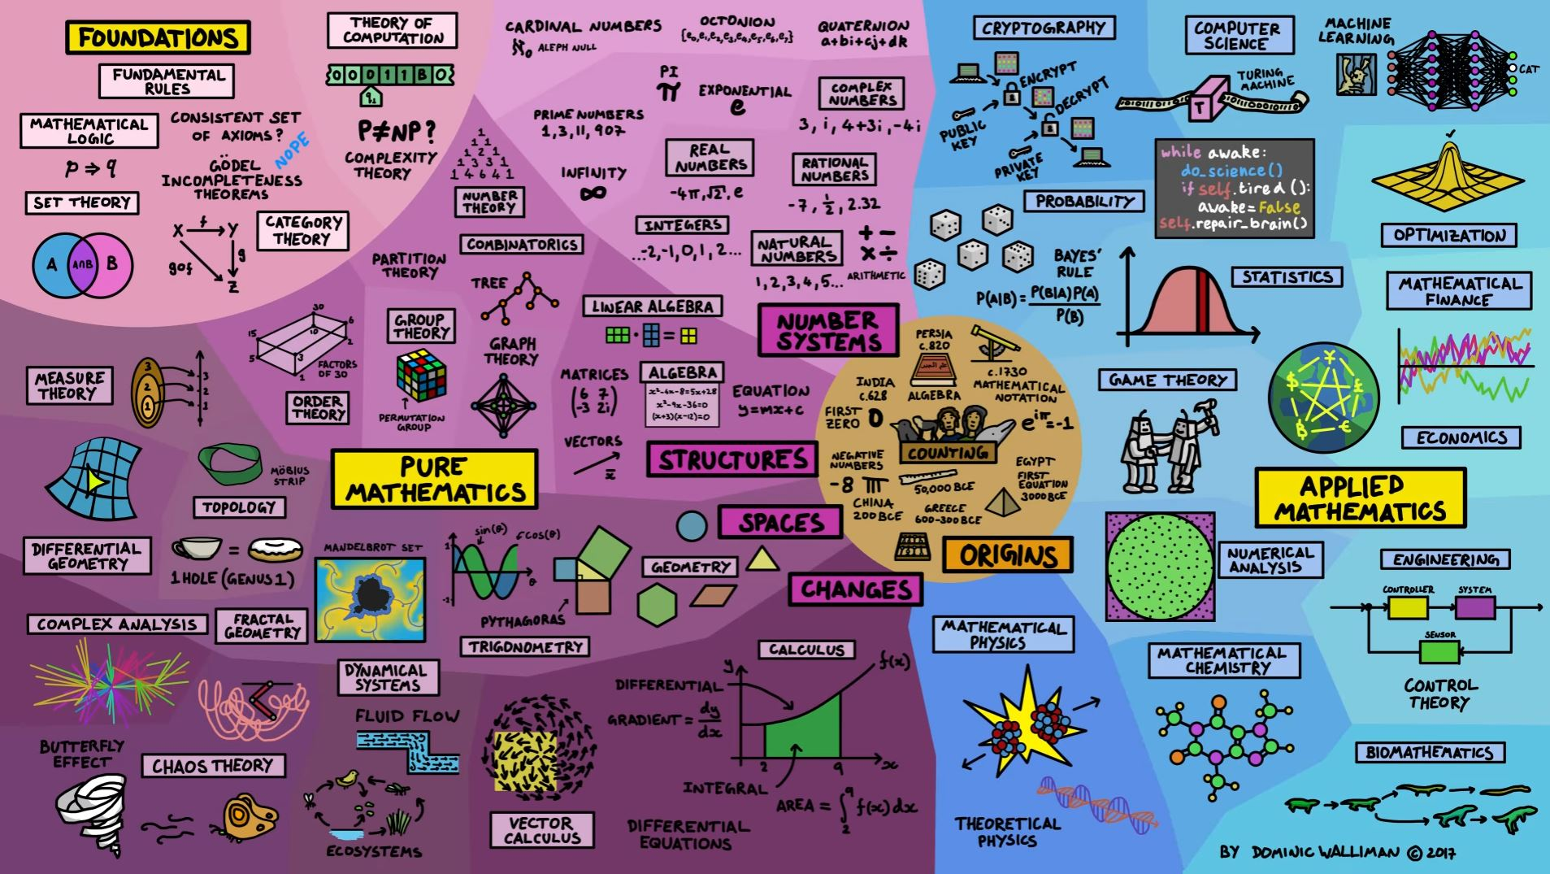
Map of Mathematics
http://www.relativelyinteresting.com/wp-content/uploads/2017/02/map-of-mathematics-hi-res.jpg

Slide 3
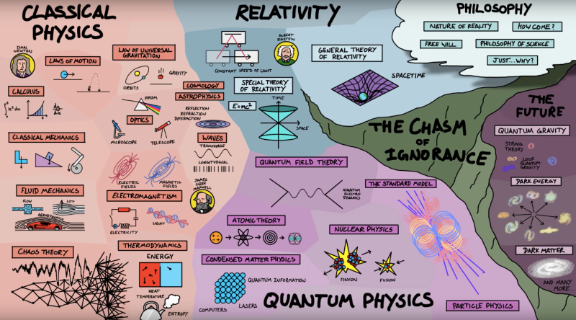
Map of Physics
http://www.sciencealert.com/images/zi8feiezrudv90wonawq.png

Slide 4
BB Schedule for S18
Tue | Topic | Fri | Topic
1/16 | Introduction | 1/19 | MatLab I (Basics)
1/23 | System | 1/26 | Convolution
1/30 | Fourier Series | 2/02 | Fourier Transform
2/06 | Signal Processing | 2/09 | Discrete FT & FFT
2/13 | MatLab II (Homework) | 2/16 | Network
2/20 | No Class | 2/23 | Exam I
2/27 | Quality & Performance | 3/02 | X-ray & Radiography
3/06 | CT Reconstruction | 3/09 | CT Scanner
3/20 | MatLab III (CT) | 3/23 | Nuclear Physics
3/27 | PET & SPECT | 3/30 | MRI I
4/03 | Exam II | 4/06 | MRI II
4/10 | MRI III | 4/13 | Ultrasound I
4/17 | Ultrasound II | 4/20 | Optical Imaging
4/24 | Machine Learning | 4/27 | Exam III
Office Hour: Ge Tue & Fri 3-4 @ CBIS 3209 | wangg6@rpi.edu
Kathleen Mon 4-5 & Thurs 4-5 @ JEC 7045 | chens18@rpi.edu

Slide 5
X-ray Imaging
Basic Knowledge
X-ray Source
Working Principle
X-ray Spectrum (General, Characteristic)
X-ray Attenuation
Scatter (Coherent, Incoherent)
Absorption (K-edge)
X-ray Detector
Energy-integrating (Dual-energy imaging)
Photon-counting

Slide 6
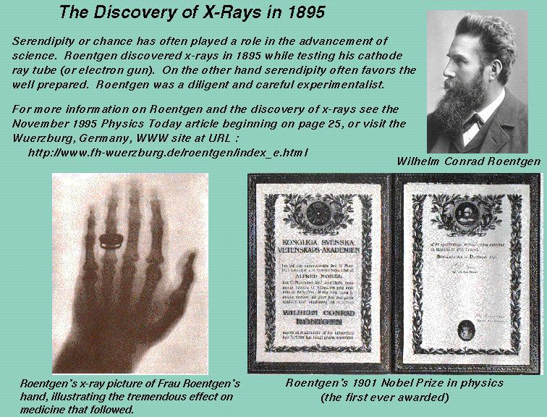

Slide 7
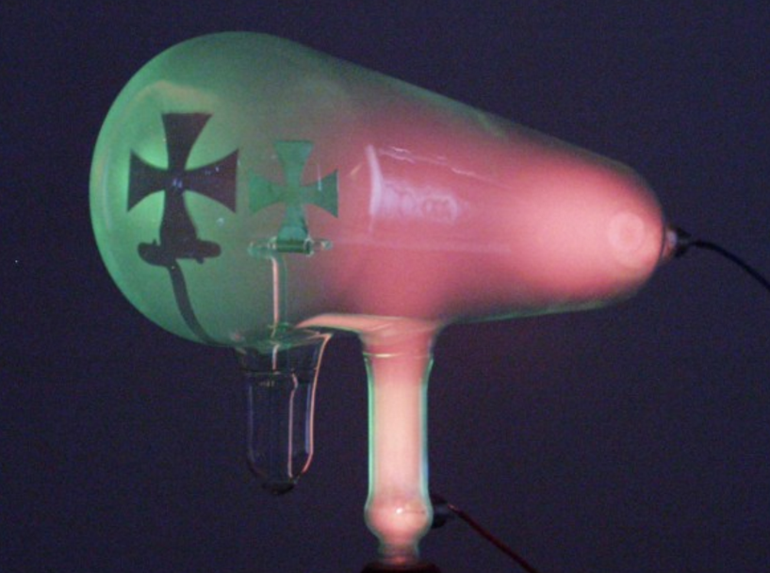
Discovery of X-rays
By Rontgen in 1895
Accidentally, in experiments with a cathode tube and a fluorescent screen
Illuminated the screen when the tube was in a box
These rays could travel through opaque materials

Slide 8
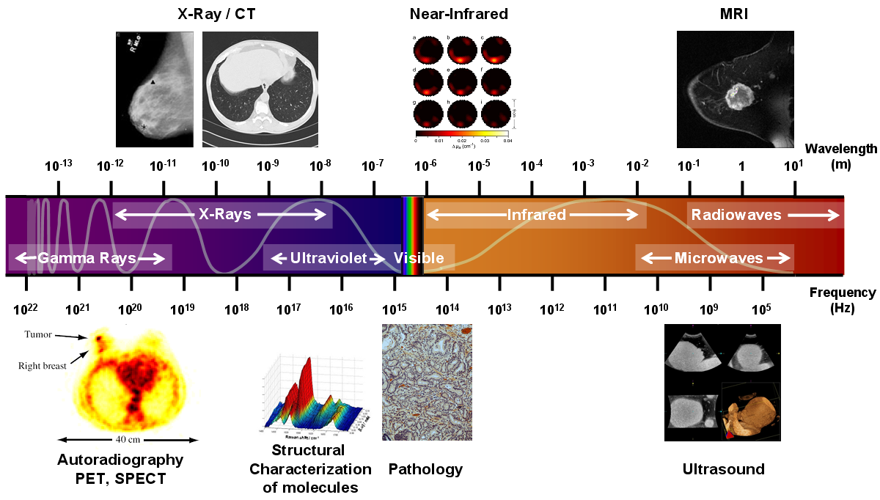
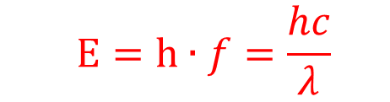
X-ray Energy
$$E=h∙f=\frac{hc}{λ}$$
Angstrom (Å)=10⁻¹⁰ m, & Nanometer (nm)=10⁻⁹ m

Slide 9
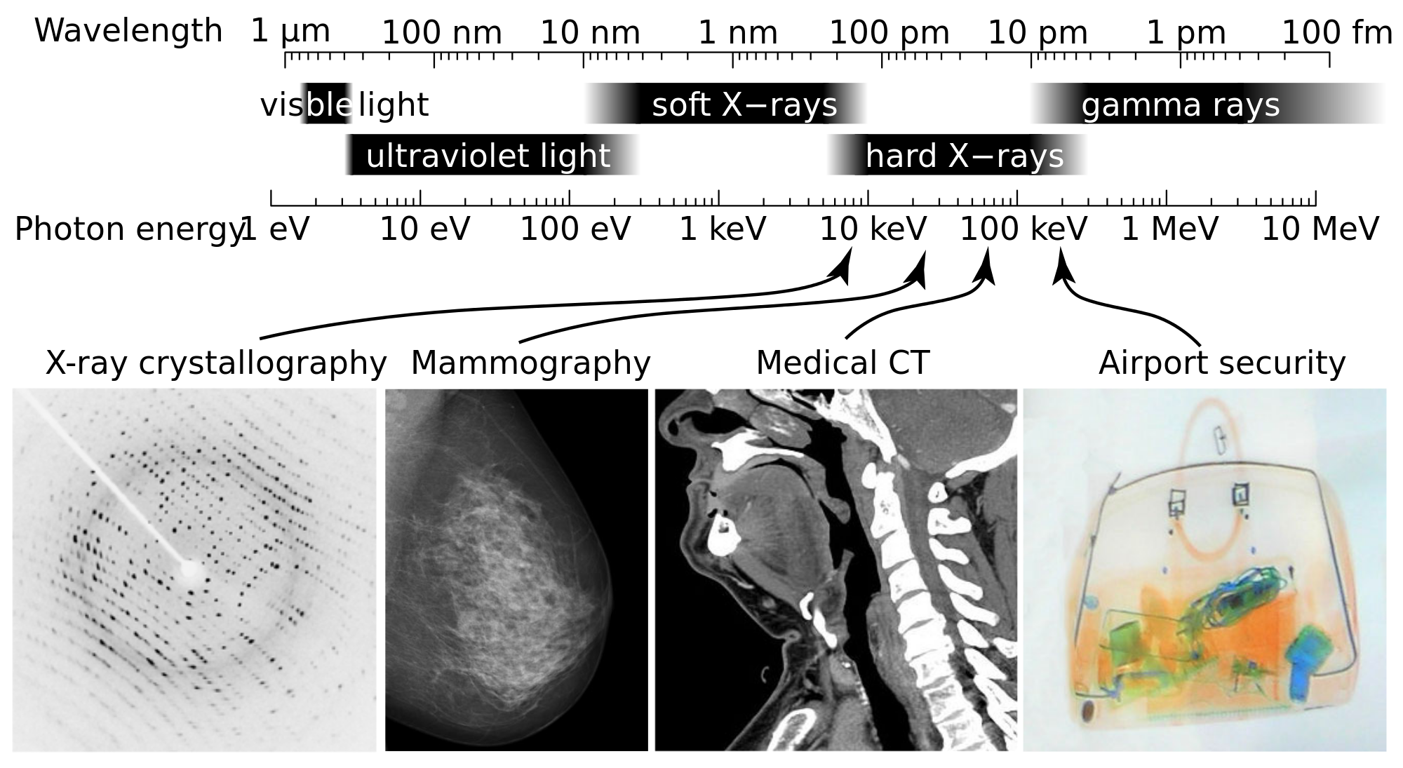
X-ray Types
Wavelength range: 0.01-10 nm, and energy range: 100 eV to 100 keV

Slide 10
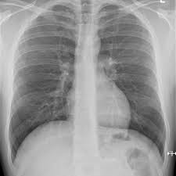
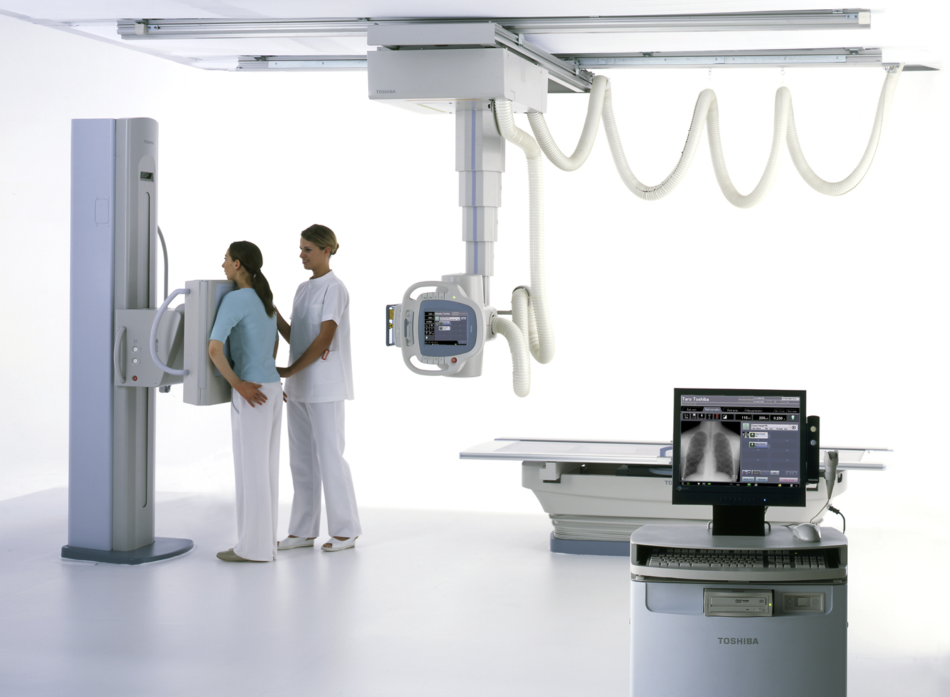
X-ray Radiography

Slide 11
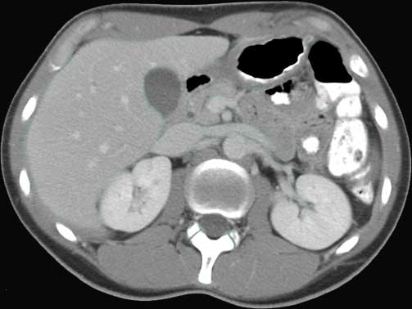
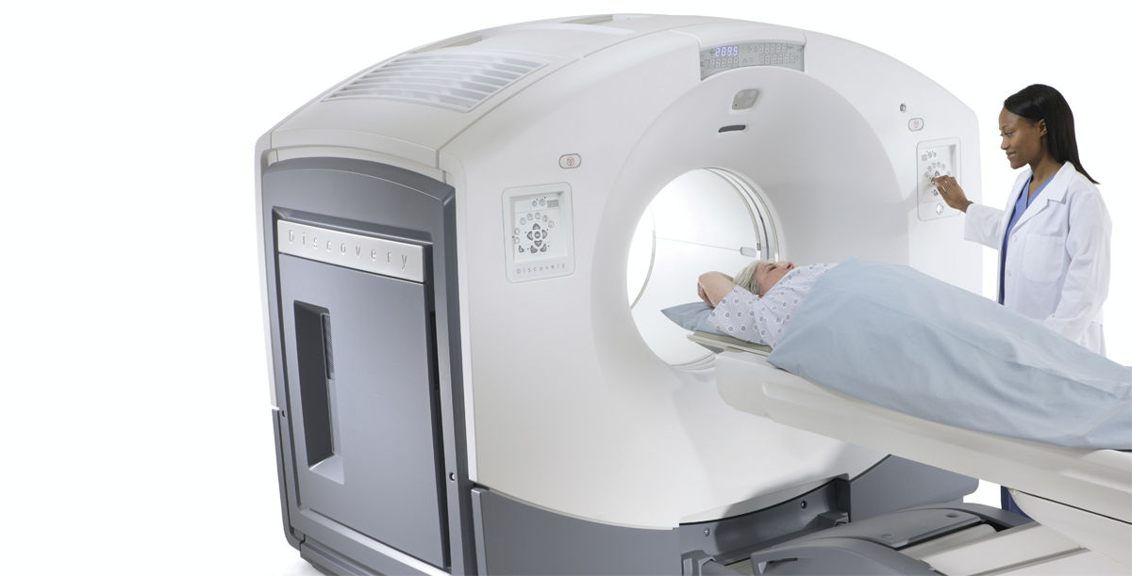
X-ray Computed Tomography (CT)

Slide 12
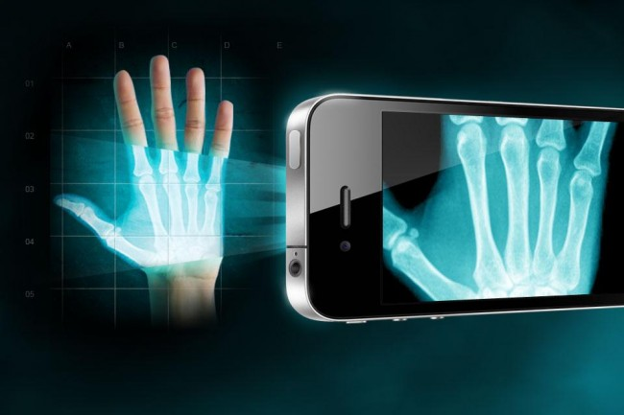
Radiography

Slide 13
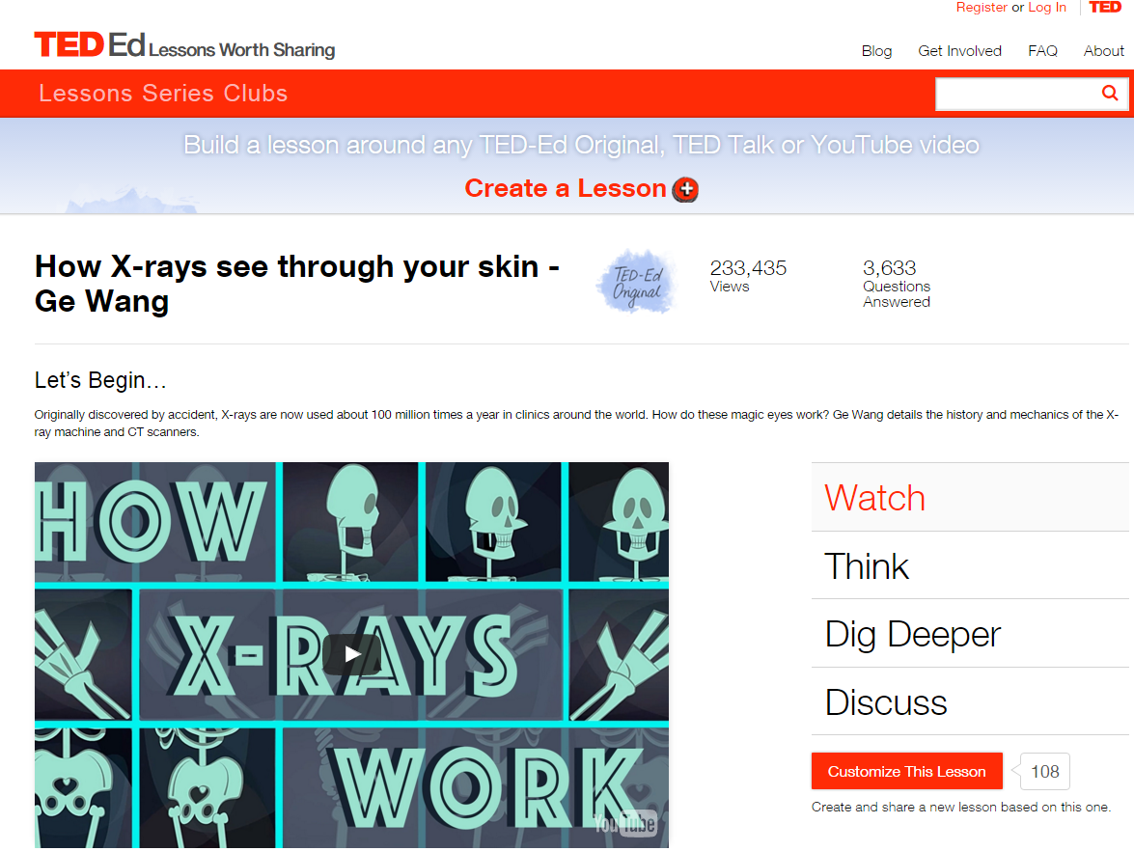

Slide 14
Medical X-rays
Relatively Cheap & Widely Available
High Resolution & Fast Speed
High Geometric Accuracy
Sensitive &/ Specific for Many Diseases
Differential Diagnostics
Ionizing Radiation
Poor Contrast in Soft Tissue
Global X-ray Market:
$7.3 billion in 2011, $9.1 billion in 2017

Slide 15
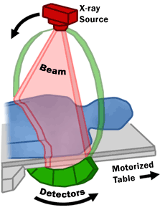
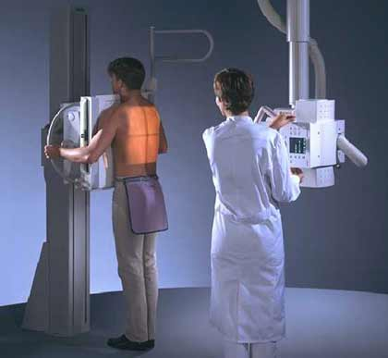
X-ray Imaging

Slide 16
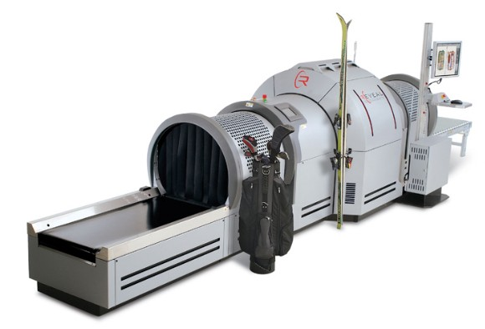
Airport Security Screening

Slide 17
X-ray Imaging
Basic Knowledge
X-ray Source
Working Principle
X-ray Spectrum (General, Characteristic)
X-ray Attenuation
Scatter (Coherent, Incoherent)
Absorption (K-edge)
X-ray Detector
Energy-integrating (Dual-energy imaging)
Photon-counting

Slide 18
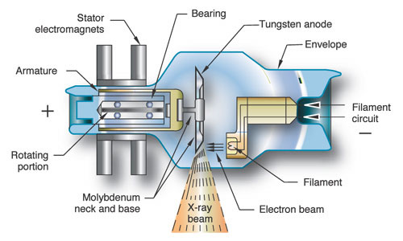
X-ray Source

Slide 19

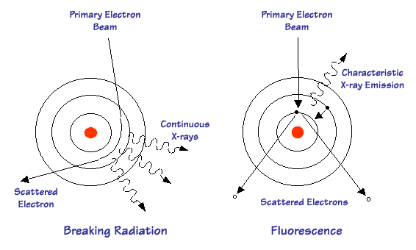
X-ray Generation
Bremsstrahlung (General)
Characteristic (Photoelectric)

Slide 20
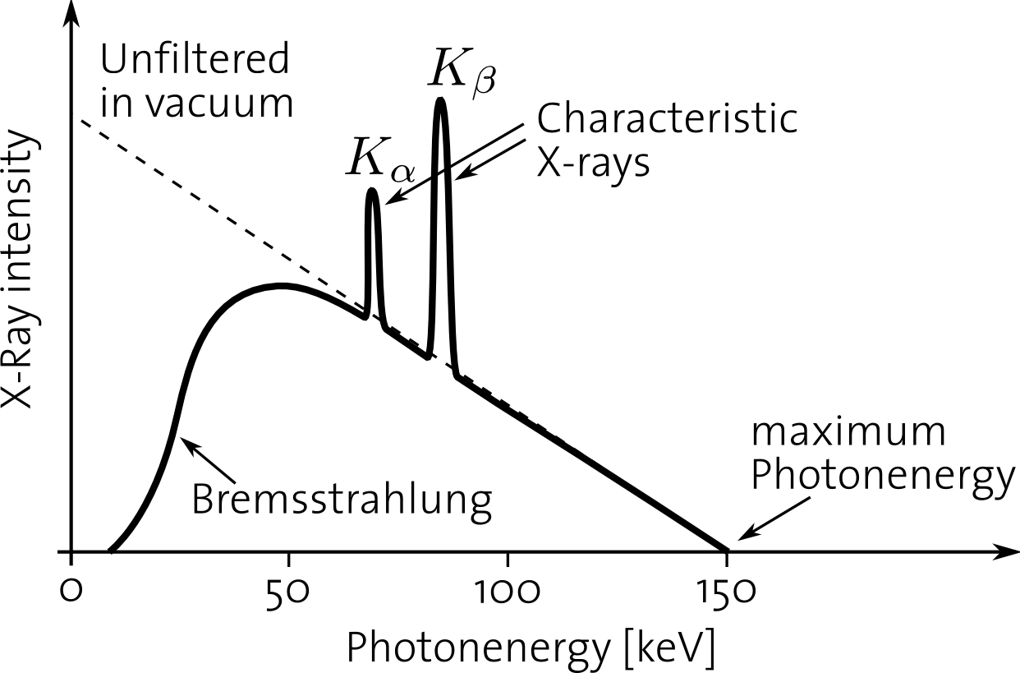
X-ray Spectrum

Slide 21
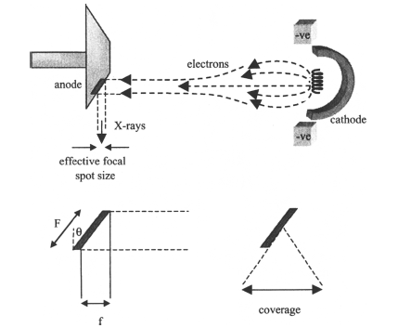
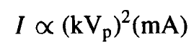
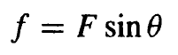
X-ray Tube Parameters
lead shield
glass/metal envelope
induction stator
rotating tungsten anode
induction
rotor
cathode
electrons
induction stator
radiotranslucent
window
X-rays

Slide 22
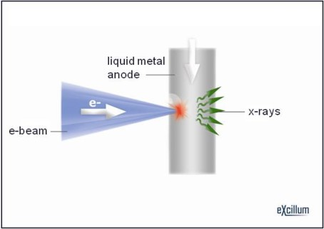
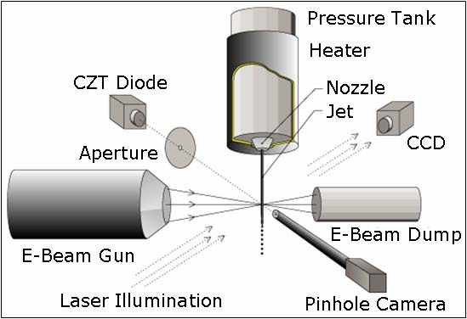
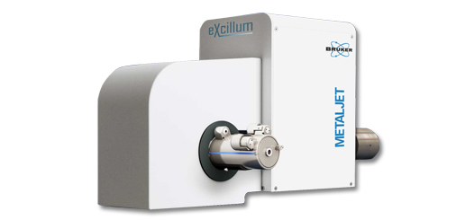

New Type of X-ray Tube

Slide 23
X-ray Imaging
Basic Knowledge
X-ray Source
Working Principle
X-ray Spectrum (General, Characteristic)
X-ray Attenuation
Scatter (Coherent, Incoherent)
Absorption (K-edge)
X-ray Detector
Energy-integrating (Dual-energy imaging)
Photon-counting

Slide 24
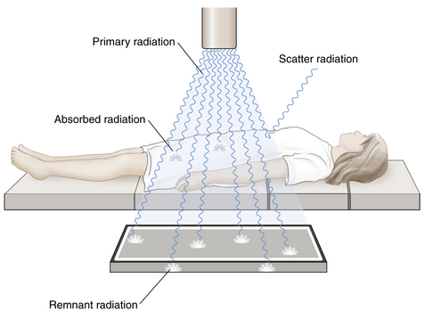
X-ray Attenuation
Interactions at Atomic Level
No interaction: Primary Beam
Total Absorption: No Signal
Partial Absorption: Photoelectric, Scattering

Slide 25
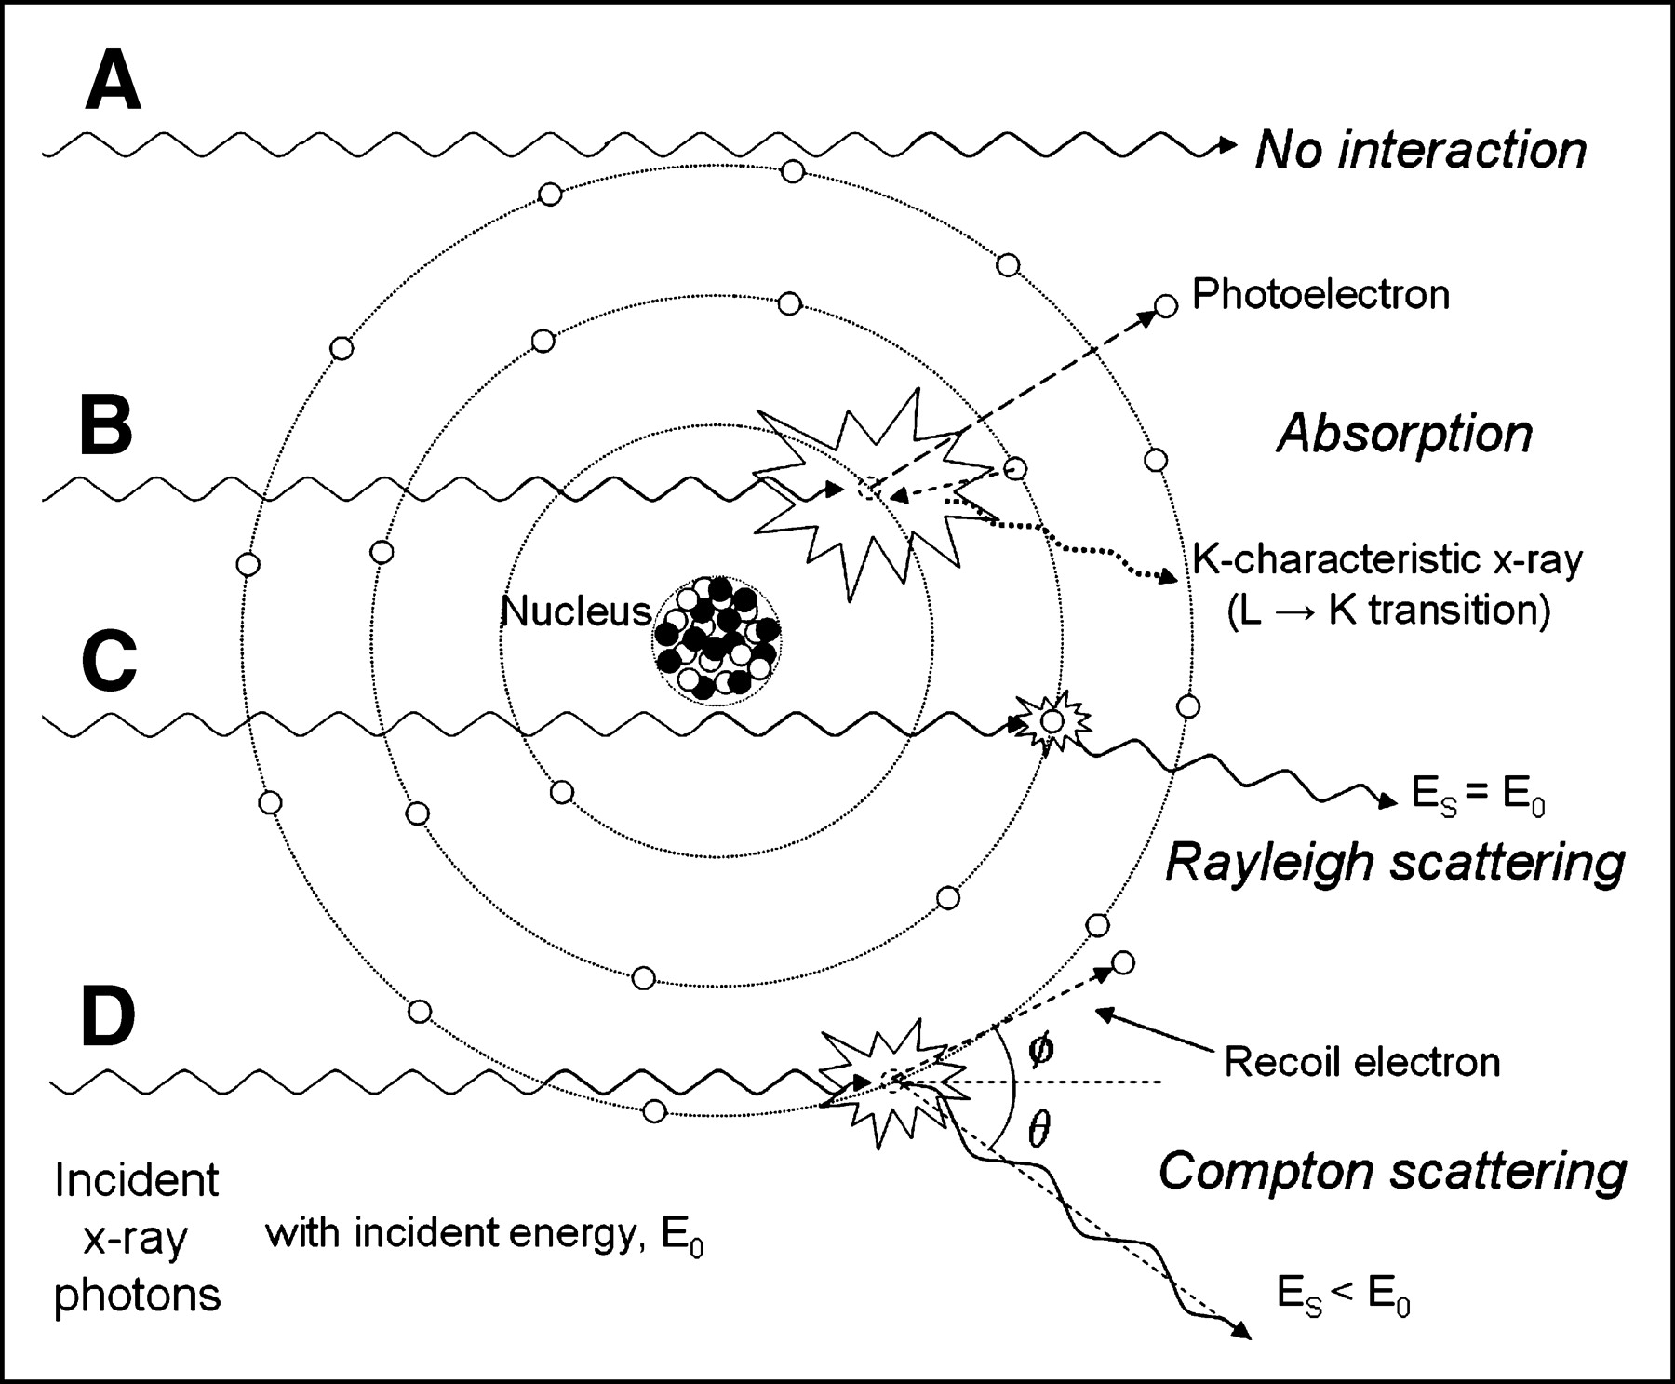
Types of Interaction

Slide 26
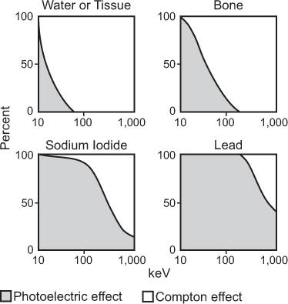
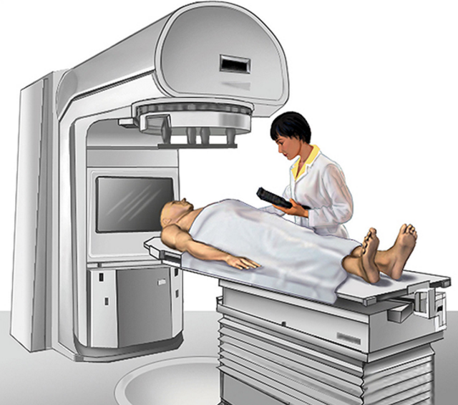
Types of Interaction
Photoelectric
Incoherent/Coherent (Compton/ Rayleigh) Scattering
<80 kVp: Photoelectric Effect
>80 kVp: Compton Scatter
Pair Production
Photodisintegration

Slide 27
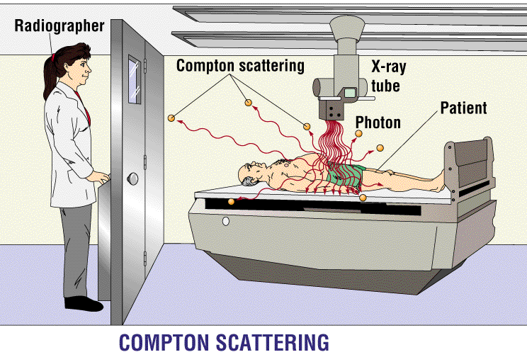
Radiation Protection

Slide 28
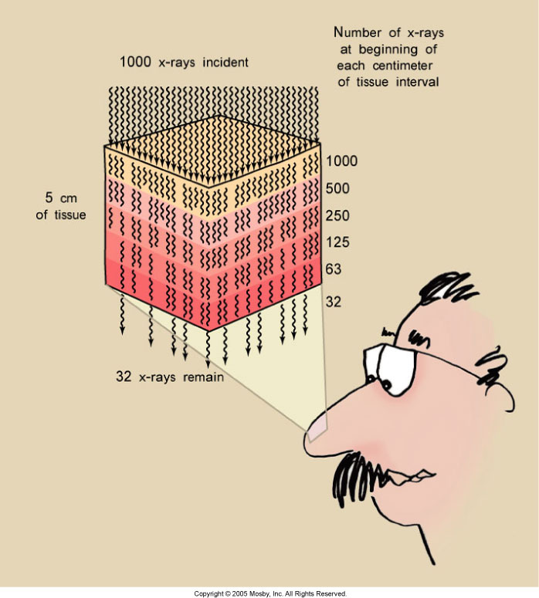
Rapidly Reduced

Slide 29
Exponential Attenuation
Attenuation Coefficient
Input Intensity
Output Intensity
μ
Ni
No
Δx
Ni
No
μ₁
μ₂
μ₃

Slide 30
Linear Equation
Ni
No
μ_{κ}
Δx
Ray-sum
Line integral

Slide 31
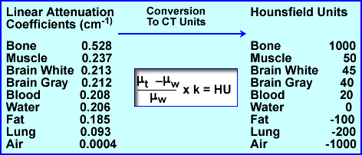
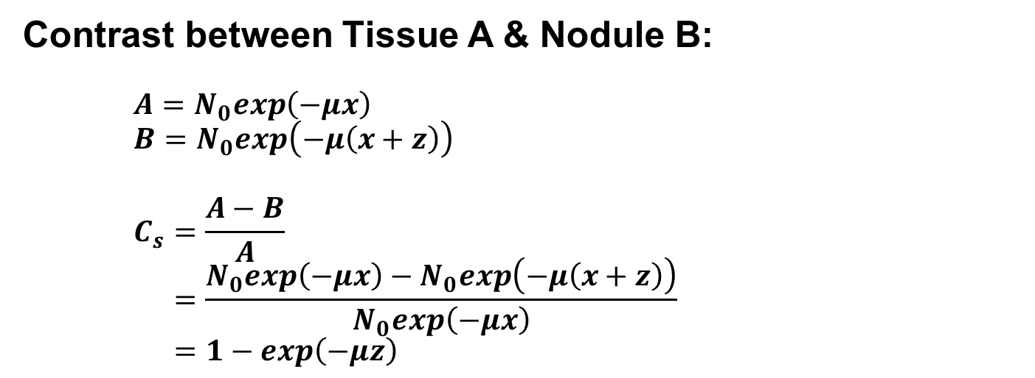
Attenuation Contrast
Contrast between Tissue A & Nodule B:
$$A=N_{0}exp\left(−μx\right)$$
$$B=N_{0}exp\left(−μ\left(x+z\right)\right)$$
$$C_{s}=\frac{A−B}{A}$$
$$=\frac{N_{0}exp\left(−μx\right)−N_{0}exp\left(−μ\left(x+z\right)\right)}{N_{0}exp\left(−μx\right)}$$
$$=1−exp\left(−μz\right)$$
Given z = 1 cm, µ = 1 cm⁻¹, Contrast = 1-exp(-1) = 0.63

Slide 32
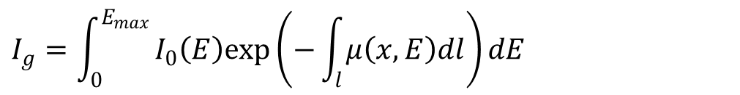
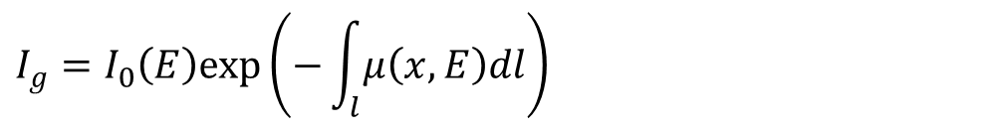
Data Model
Monochromatic Model
$$I_{g}=I_{0}\left(E\right)exp\left(−\int_{l}{μ\left(x,E\right)dl}\right)$$
Polychromatic Model
$$I_{g}=\int_{0}^{E_{max}}{I_{0}\left(E\right)exp\left(−\int_{l}{μ\left(x,E\right)dl}\right)dE}$$

Slide 33
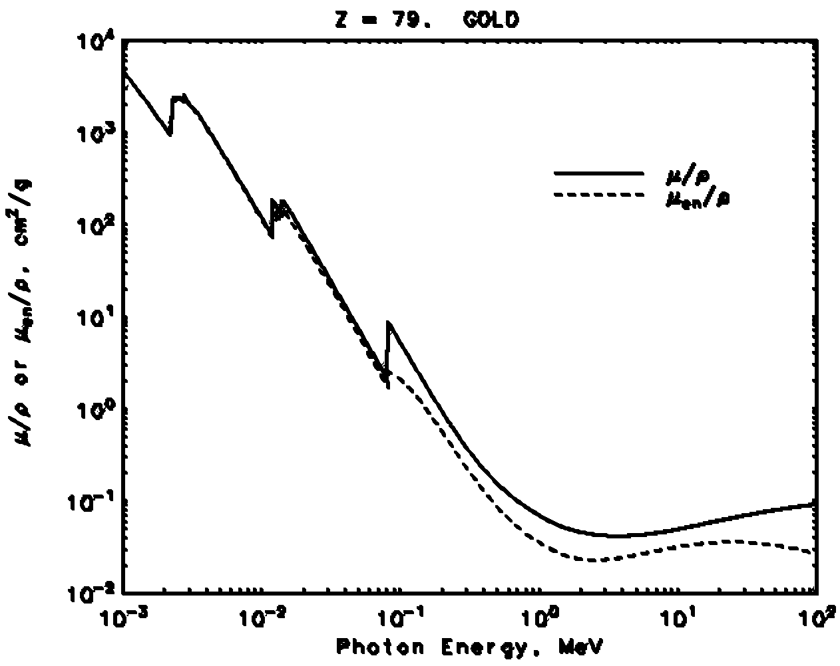
X-ray K-edge
80.7keV
http://www.nist.gov
Kim, C. K., Ghosh, P., & Rotello, V. M.: Multimodal drug delivery using gold nanoparticles. Nanoscale, 1(1):61-67, 2009

Slide 34
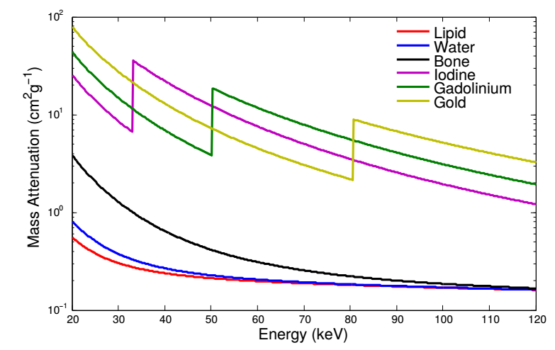
X-contrast Agents
https://arxiv.org/pdf/1506.04223.pdf

Slide 35
X-ray Imaging
Basic Knowledge
X-ray Source
Working Principle
X-ray Spectrum (General, Characteristic)
X-ray Attenuation
Scatter (Coherent, Incoherent)
Absorption (K-edge)
X-ray Detector
Energy-integrating (Dual-energy imaging)
Photon-counting

Slide 36
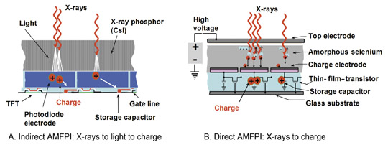
Energy-integrating Detector

Slide 37
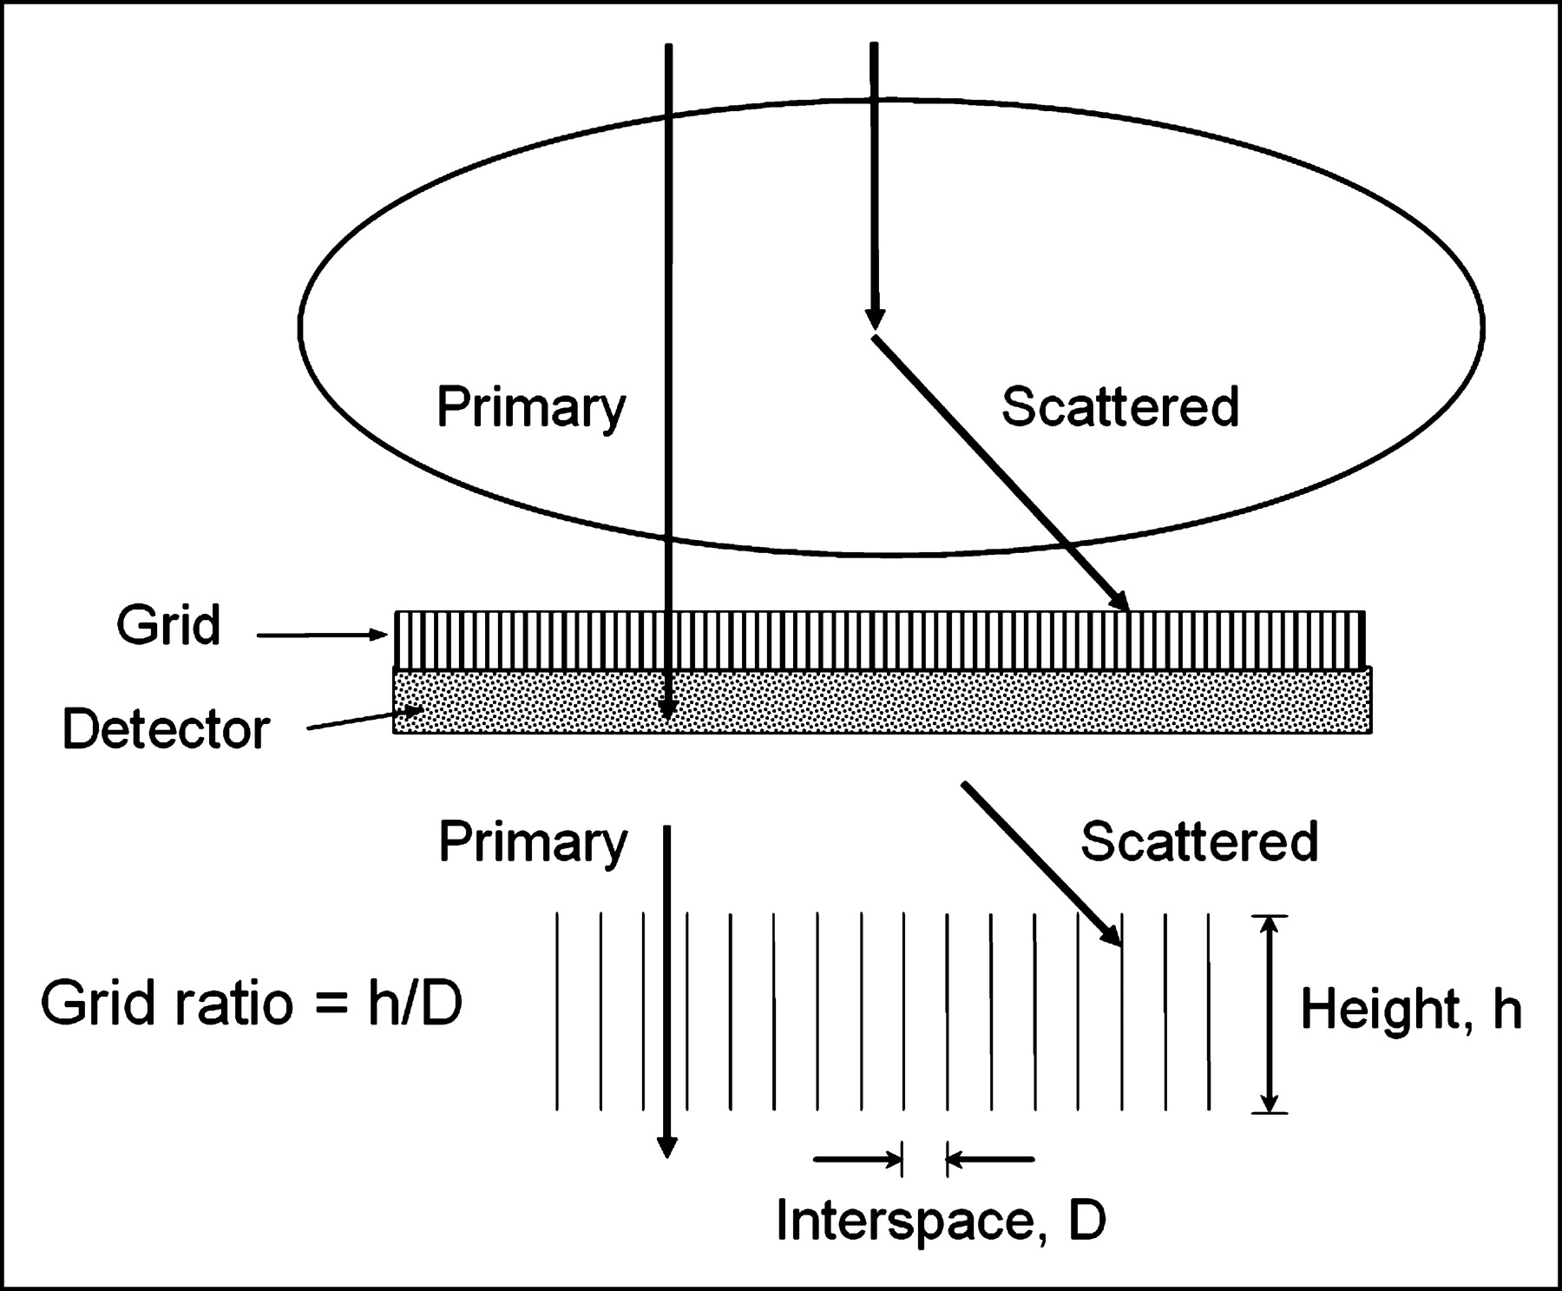
Anti-scatter Grid

Slide 38
With & Without Grid
With Grid
Without Grid

Slide 39
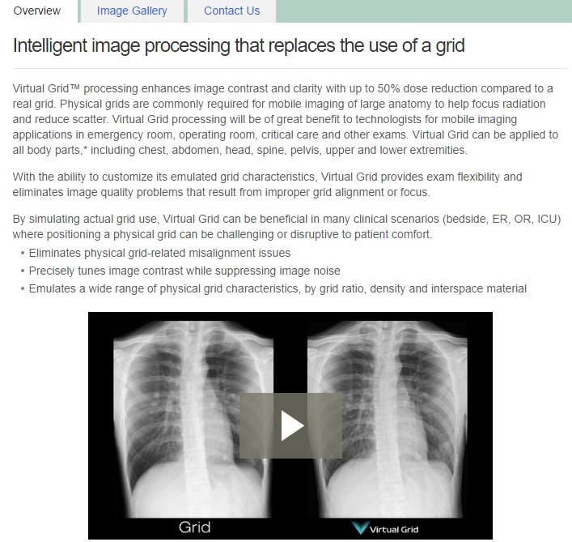
Virtual Grid

Slide 40
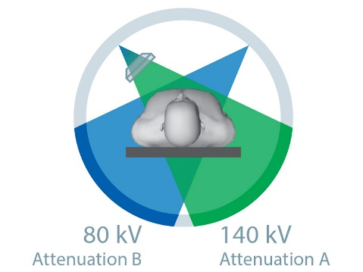
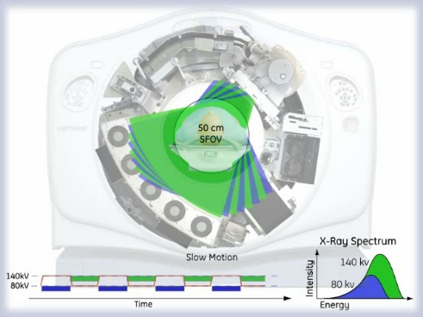
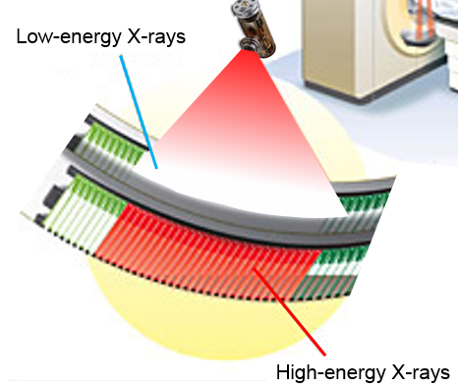
Dual-energy Imaging
Dual-Source
Dual-kVp
Dual-Layer

Slide 41
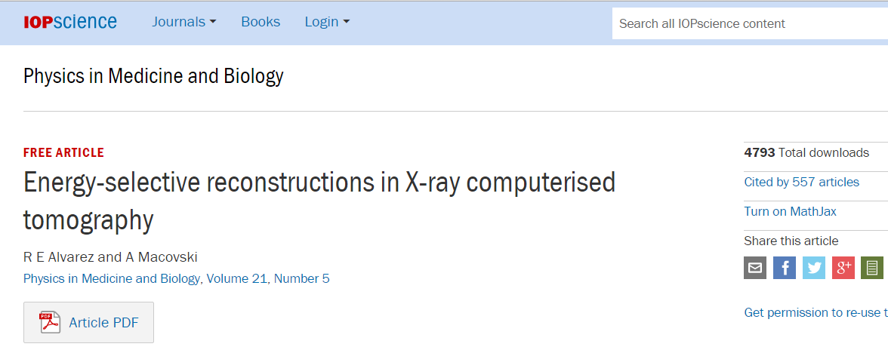
Classic Paper on Dual-energy CT

Slide 42
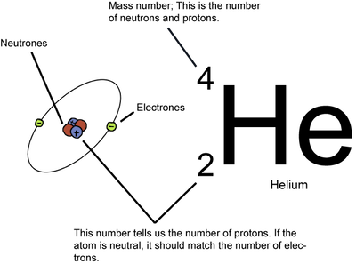
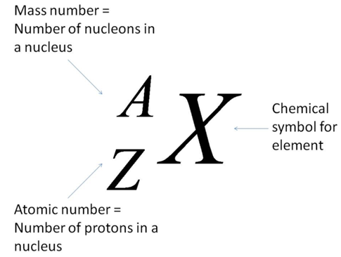
Atomic Number & Mass Number
Atomic Number (Z): the number of protons in its nucleus
Atomic Weight (≃A): In most cases the mass number, equal to the total number of protons and neutrons

Slide 43
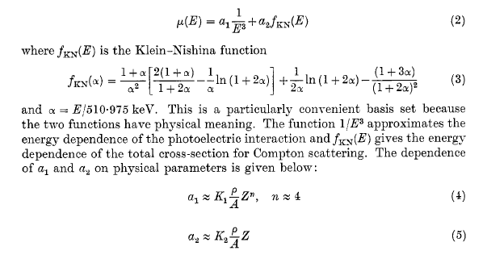
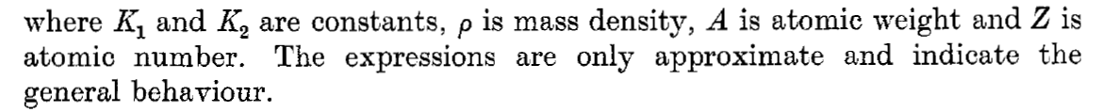
Classic Expression

Slide 44

Dual-Energy Measurement

Slide 45
Photon-counting CT
Averaged
Linear Attenuation
Over Whole X-ray Spectrum
Conventional CT
Rotation
Photon-integrating
Detector
Air
Water
Gold
10mg/ml
Fat
50%
Full Spectrum
For K-edges
In Many Energy Bins
Spectral Molecular CT
600
X-ray Tube
Iodine
20mg/ml
Calcium 150mg/ml
Photon-counting
Detector
Multi-material Phantom
0

Slide 46


Photon-counting Detector

Slide 47
K-edge Imaging

Slide 48



High Dose Efficiency CT System
(with Stanford & GE GRC)
The final system o be integrated at RPI
The goal is to develop dose-saving technologies for key CT components and demonstrate their clinical benefits – General-purpose CT scanning will be at radiation dose <1mSv with spectral imaging capabilities and the largest improvement in CT resolution over the past 30 years.
Multi-PIs: Norbert Pelc, Pete Edic, & Ge Wang, NIH U01 EB017140, 7/14-6/18

Slide 49

Radiology Paper

Slide 50

First Human Images

Slide 51

Amazing Design
Rod
Cone
Vertebrate Retina

Slide 52
Hybrid Detector Array

Slide 53

James’ Dissertation

Slide 54





Slide 55


Computed Tomography
The paradigm is being shifted from grey-scale and dual-energy towards spectral CT. A mouse is material-wise decomposed with a photon-counting detector Medipix, where iodine is in red for pulmonary circulation, barium is in blue with the lung, and soft tissue is in grey (Universities of Canterbury and Otago, New Zealand).

Slide 56
BB12 Homework
Page 50, Problem 1.1
Page 51, Problem 1.3
Page 51, Problem 1.6
Due Date: Same (Week Later)

